Slide 1
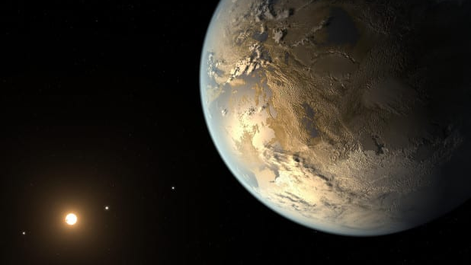
HOW TO USE MACHINE LEARNING FOR DETECTION OF EXOPLANETS

Slide 2

INTRODUCTION
An exoplanet is any planet beyond our solar system. They are detected by astronomers by observing the intensity of their parent stars. Exoplanets are made up of elements similar to those of the planets in our solar system, but their mixes of those elements may differ.
Exoplanets come in a wide variety of sizes, from gas giants larger than Jupiter to small, rocky planets about as big around as Earth or Mars.

Slide 3
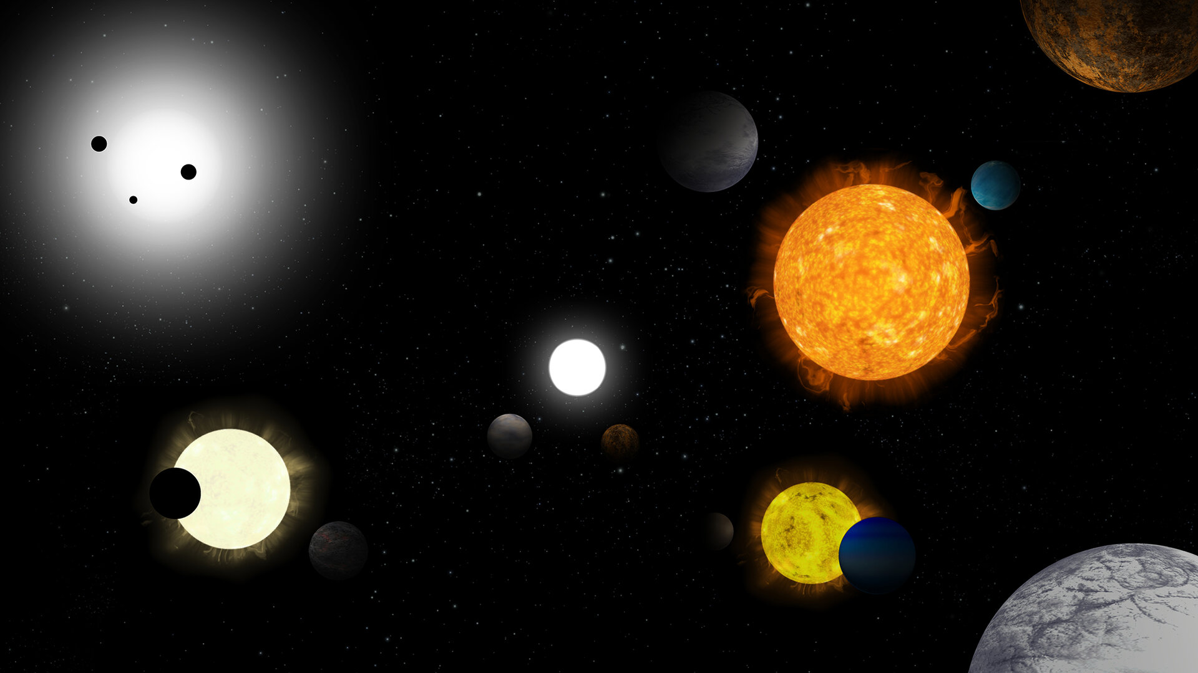
HISTORY
Early claims to have detected exoplanets were made in the 19th century, notably by William Jacob.
In 1855, William saw deviations in the orbits within the nearby 70 Ophiuchi binary star system.
The first time we actually detected an exoplanet was in 1917 NASA’s JPL but wasn’t confirmed

Slide 4
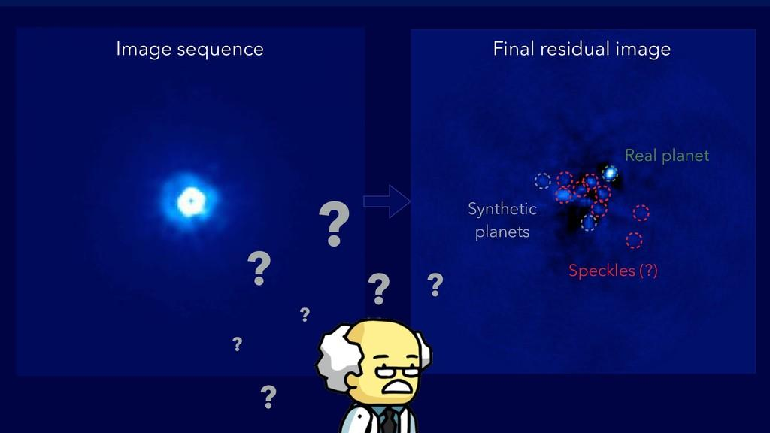
WHY DO WE HUNT FOR EXOPLANETS

Slide 5
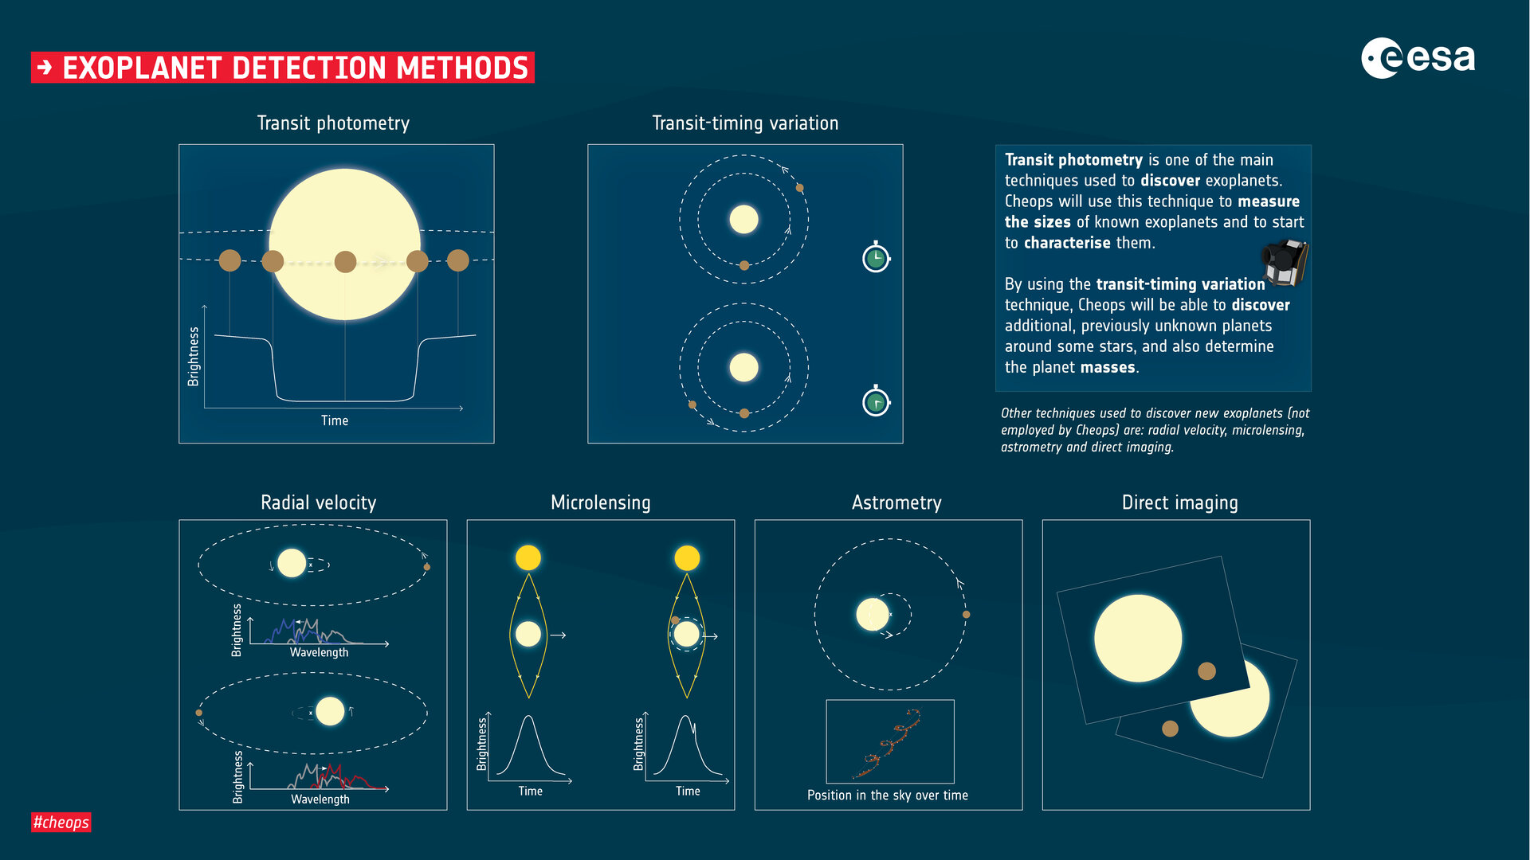

Slide 6
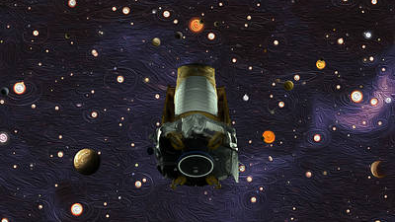
KEPLER SPACE TELESCOPE
IN THIS PROJECT WE ARE GOING TO USE DATA FROM THE KEPLER SPACE TELESCOPE AND SOLVE OUR PROBLEM OF EXOPLANET DETECTION
WE WILL BE USING THE TRANSIT PHOTOMETRY METHOD FOR DETECTION

Slide 7

TRANSIT METHOD
The transit method is a photometric method that aims to indirectly detect the presence of one or more exoplanets in orbit around a star.
The transit method consists of regularly measuring the luminosity of a star in order to detect the periodic decrease in luminosity associated with the transit of an exoplanet.

